Slide 1
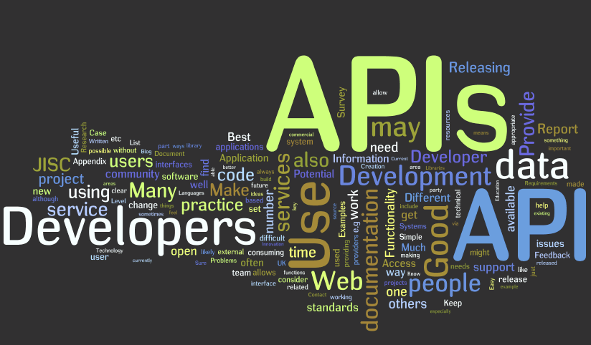
Web API
Priyanka S
Pavani T
Bhanu Sri K
Bhavitha A

Slide 2
Content
Overview REST Services & SOAP
WCF Soap, WCF REST, Web API
HTTP Methods(verbs)
CORS
OAuth
HTTP headers
Routing
Authorization Filters
JSON and XML Serialization
Model Validation
Security (Anti-Forgery token, etc.)

Slide 3
Web Services
Why Web Services?
Exposing the existing function on to network
Connecting Different Applications ie Interoperability:
Standardized Protocol
Low Cost of communication

Slide 4

SOAP!

Slide 5
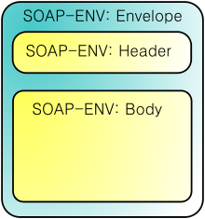
SOAP
SOAP is a protocol for exchanging structured information in the implementation of web services.
Transport : SMTP and HTTP
Message Format :XML(In the form of Envelopes)
Specifications are exposed through WSDL.
SOAP Request structure:

Slide 6
SOAP Message Content
<?xml version="1.0"?>
<soap:Envelope
xmlns:soap="http://www.w3.org/2003/05/soap-envelope/"
soap:encodingStyle="http://www.w3.org/2003/05/soap-encoding">
<soap:Header>
<m:Trans xmlns:m="https://www.w3schools.com/transaction/"
:soap:mustUnderstand="1"
soap:actor="https://www.w3schools.com/appml/">234
</m:Trans>
</soap:Header>
<soap:Body>
<m:GetPrice xmlns:m="https://www.w3schools.com/prices">
<m:Item>Apples</m:Item>
</m:GetPrice>
</soap:Body>
</soap:Envelope>
SOAP Headers
Actor
Must Understand
SOAP BODY
The required SOAP Body element contains the actual SOAP message intended for the ultimate endpoint of the message.

Slide 7
SOAP - Java Implementation
JAX-WS
RPC-style
Document style
Has two approaches :
Top-down-contract first or WSDL first
Bottom-up-Service first or code first

Slide 8
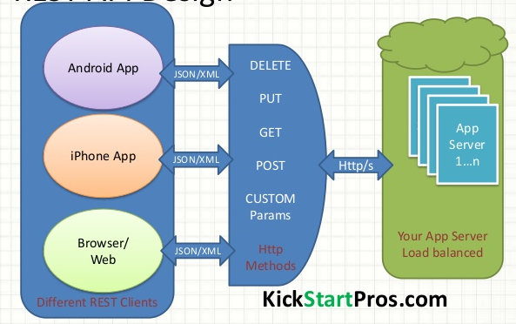
REST
REST stands for Representational State Transfer.
REST is based on the representation of resources.
No proxies needed. Uses Http Client.
Supports JSON Format.

Slide 9
REST-Java implementations
JAX-RS
Apache-CXF
Jersey
JBoss-RestEASY

Slide 10
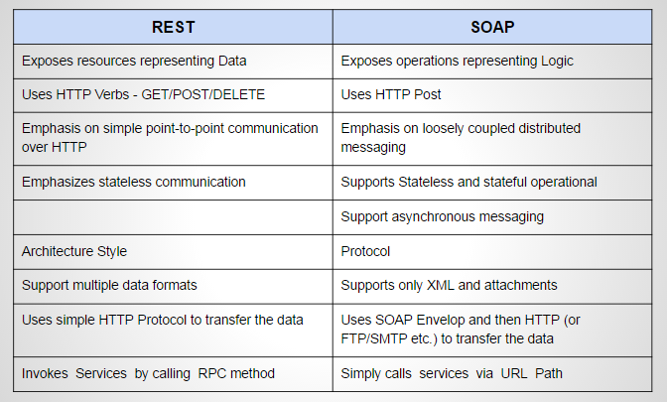
SOAP VS REST

Slide 11
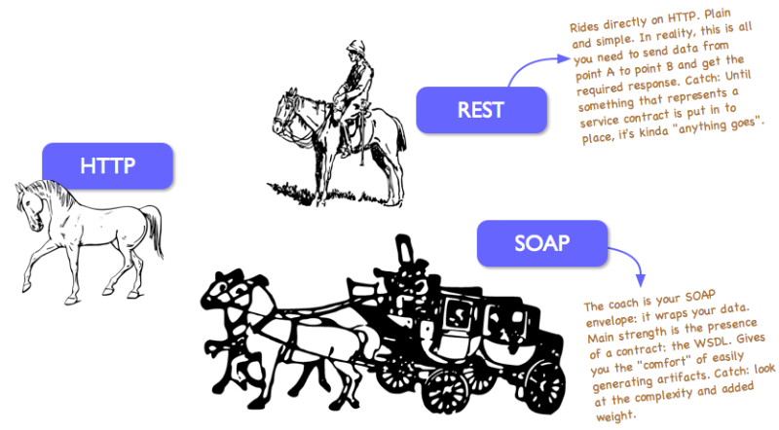
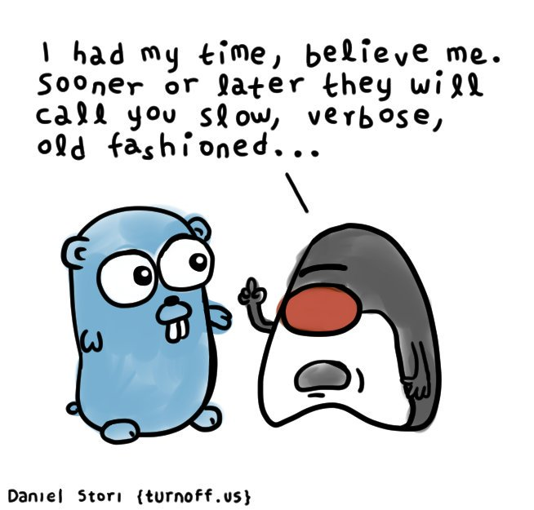

Slide 12
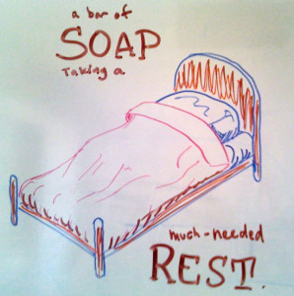

Slide 13
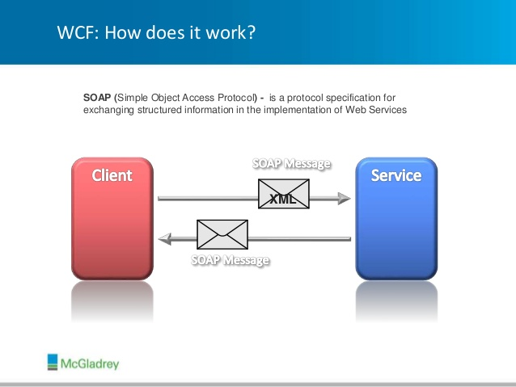
WCF & WCF REST
WCF stands for Windows Communication Foundation. It is a framework for building, configuring, and deploying network-distributed services.
Windows Communication foundation is a web service application which supports both SOAP and Rest .
ABCs (Address, bindings and contracts) are what the whole WCF service is dependent on choosing its request/response mechanism.
A service endpoint can be part of a continuously available service hosted by IIS, or it can be a service hosted in an application.

Slide 14
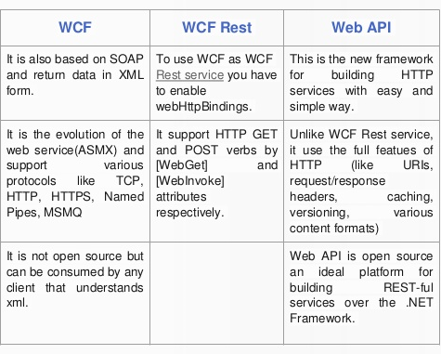

Slide 15
Web API

Slide 16
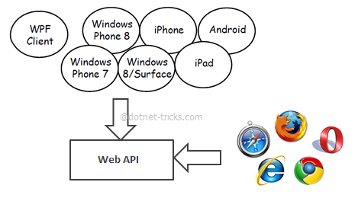
What is Web API
Web API is the great framework to build HTTP services that reach a broad range of clients, including browsers and mobile devices.
s.
Notes:
Today, a web-based application is not enough to reach it's customers. People are very smart, they are using iphone, mobile, tablets etc. devices in its daily life. These devices also have a lot of apps for making the life easy. Actually, we are moving from the web towards apps world.
So, if you like to expose your service data to the browsers and as well as all these modern devices apps in fast and simple way, you should have an API which is compatible with browsers and all these devices.
For example twitter,facebook and Google API for the web application and phone apps.

Slide 17
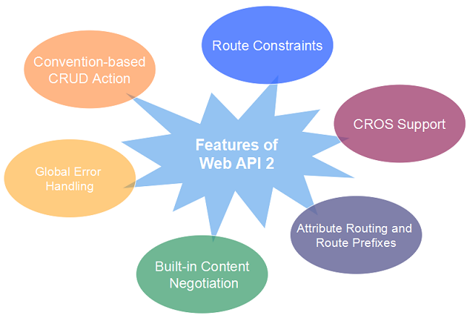
Features of Web API
Notes:
It supports convention-based CRUD Actions since it works with HTTP verbs GET,POST,PUT and DELETE.
It is only based on HTTP and easy to define, expose and consume
Content Negotiation based on Accept headers for request and response serialization
Easily extensible Formatter support to add new input/output types
It is lightweight architecture and good for devices which have limited bandwidth like smart phones.

Slide 18
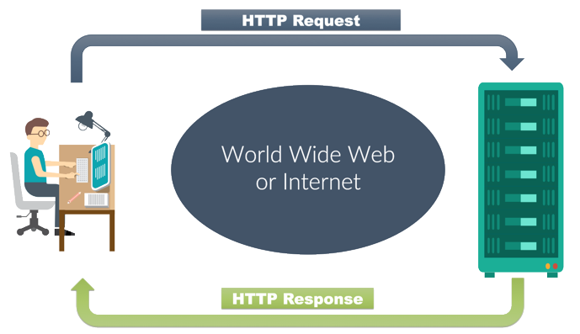
HTTP Request and Response Messages

Slide 19
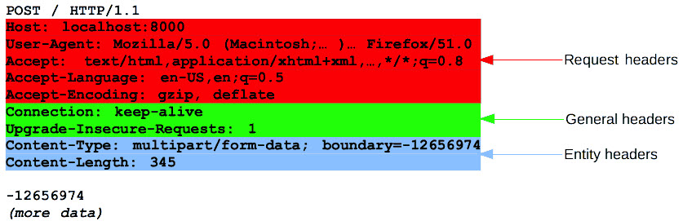
Message Structure

Slide 20
General Headers
Date
Cache-Control
Connection
Request Headers
User-agent
Accept
Accept-language
Accept-Encoding
Referrer
Entity Headers
Content-length
Content-Encoding
Content-Type
Content-language
Response Headers
Server
Set-Cookie
Accept-Ranges

Slide 21
HTTP Methods

Slide 22
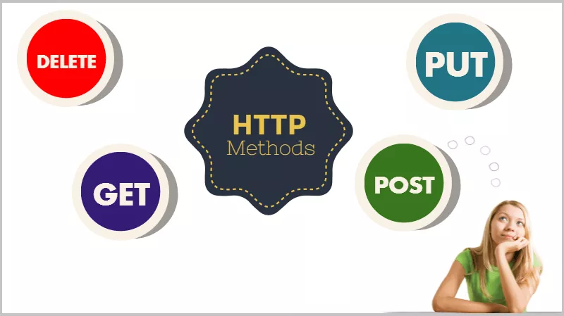

Slide 23
GET
It is used to retreive data from a server at the specified resource.
PUT
It is used to send data to the API to create or update a resource.
Post
It is used to send data to the API server to create or update a resource.
The data sent to the server is stored in the request body of the HTTP request.
Delete
It is used for delete the resource at the specified URL.

Slide 24
Head
This is identical to a GET request, but only returns the headers for the response, not the response body
Theoretically faster, commonly used for checking to see if a particular resources exists or can be accessed.
Options
Returns the HTTP methods supported by the server for the specified URL.
PATCH
Submits a partial modification to a resource. If you only need to update one field for the resource, you may want to use the PATCH method.

Slide 25
Status Codes
HTTP status codes maintained by the W3C and the Internet Assigned Numbers Authority (IANA) in their Official Registry for the HTTP specification.
Http implements a wide variety of status codes which are grouped into five categories:
1XX Codes:Informational codes. Rarely used in modern web apps.
2XX Codes:Success codes. Tells the client that the request succeeded.
3XX Codes:Redirect codes. Tells the client that they may need to redirect to another location.
4XX Codes:Client Error codes. Tells the client that something was wrong with what it sent to the server.
5XX Codes: Server Error codes. Tells the client that something went wrong on the server's side, so that the client may attempt the request again, possibly at a later time.

Slide 26
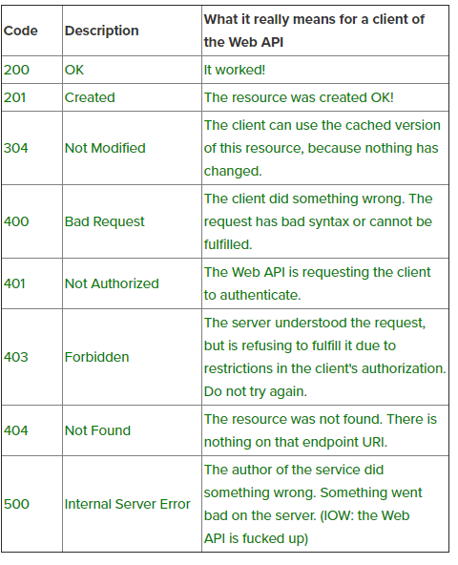

Slide 27
Routing
Web API supports two types of routing 1. Convention based routing 2. Attribute routing

Slide 28
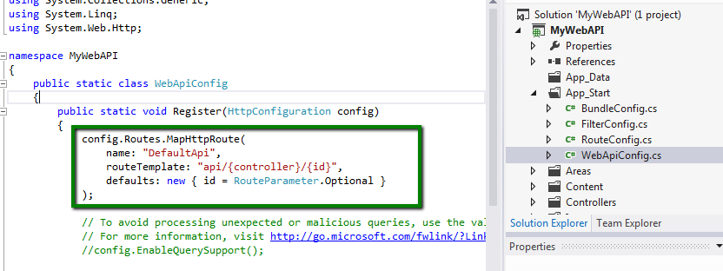
Convention Routing

Slide 29
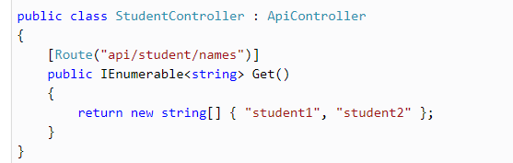
Attribute Routing

Slide 30
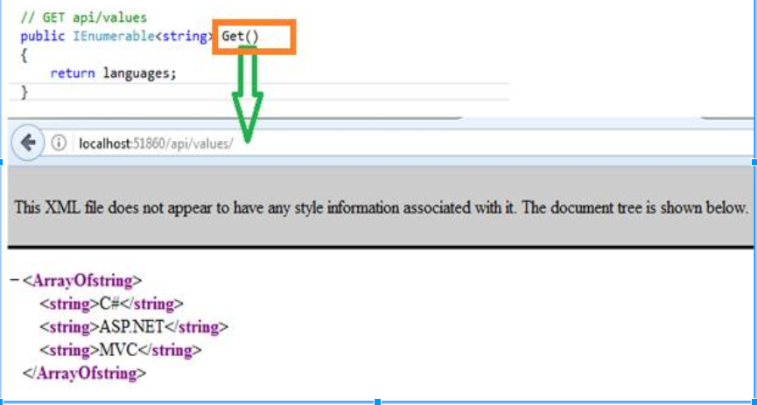

Slide 31
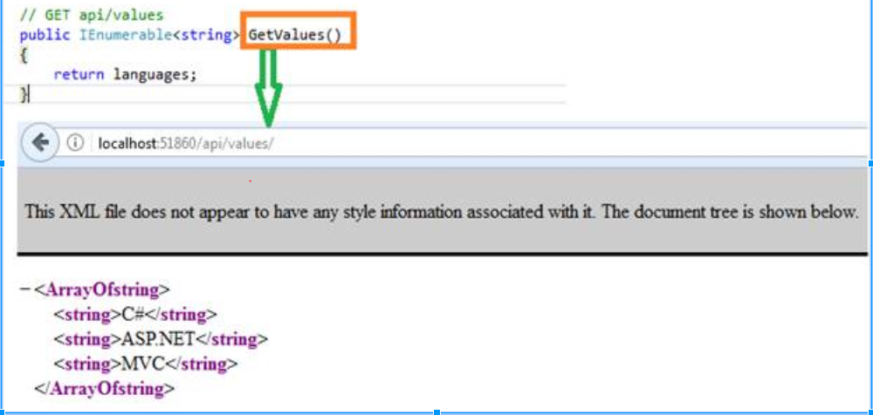

Slide 32
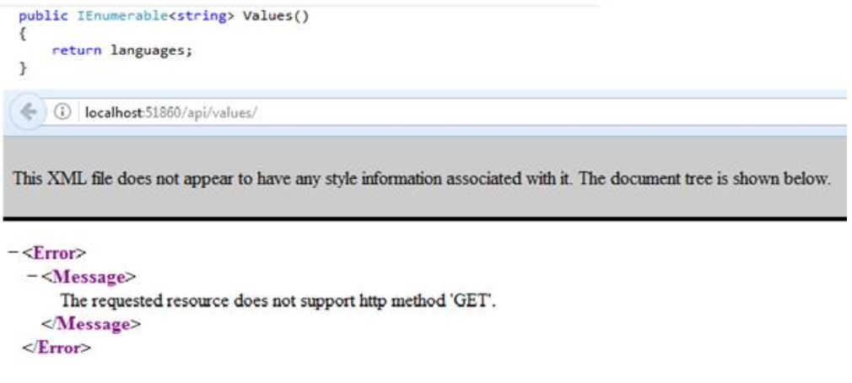

Slide 33
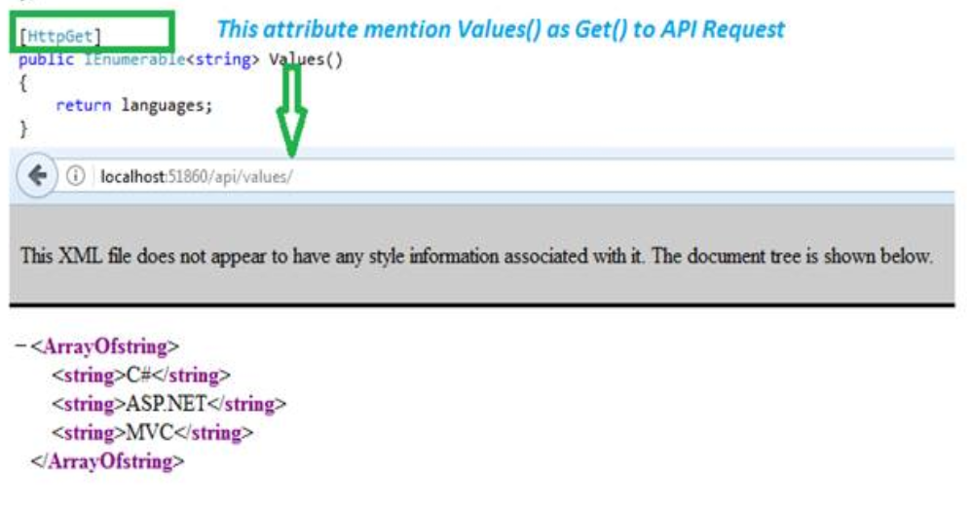

Slide 34
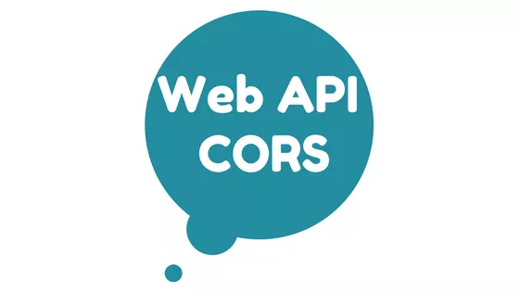
CROSS
ORIGIN
Resource
SHARING

Slide 35
Problem without CORS

Slide 36
When an Web API is hosted in one domain and the other application (different domain) tries to access the Web API for consuming data.

Slide 37
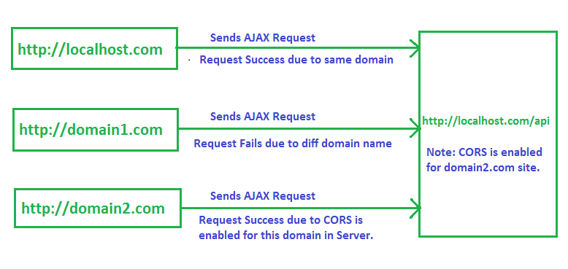

Slide 38
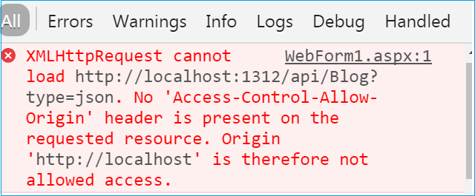

Slide 39

Why ?

Slide 40
Browsers restrict cross origin HTTP request.
It has restriction of same origin policy
Same Origin Policy:
Browser only allow request from same domain.

Slide 41
Examples:
Same origin : http://example.com/f1.html
http://example.com/f2.html
Different Origin: http://example.net (Different Domain)
Different subdomain: http://www.example.com/f1.html
Different Scheme: https://example.com/f1.html
Different port: http://example.com:2000/f1.html

Slide 42


Slide 43
Using JSONP
Using Microsoft.AspNet.WebAPI.CORS

Slide 44
JSONP
JSON
{
“FirstName”:”Mark”,
“LastName”:”Hasting”,
“Gender”:”Female”
}
It stands for JSON with Padding.
All it does is wraps the data in a function
JSONP
Callbackfunction({
“FirstName”:”Mark”,
“LastName”:”Hastings”
“Gender”:”Female”
})

Slide 45
Disadvantages using JSONP
Incompatible in old browser
Security issue which can steal your cookies(leads to a whole bunch of potential problems).

Slide 46
Using Microsoft.AspNet.WebAPI.CORS

Slide 47
For Register/enable CORS we are going to use EnableCorsAttribute class and it takes four params(4th one is optional).
EnableCorsAttribute cors = new EnableCorsAttribute("http://localhost:80/DemoApp/WebForm1.aspx", "*", "GET,POST");

Slide 48
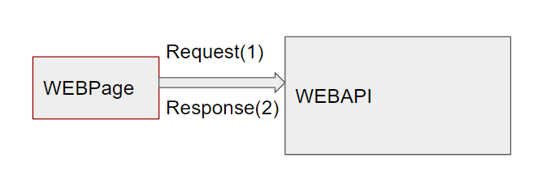
1. Browser sends HTTP request (Origin)
2. Server(WEBAPI) responds with HTTP response(Access control allow origin)

Slide 49
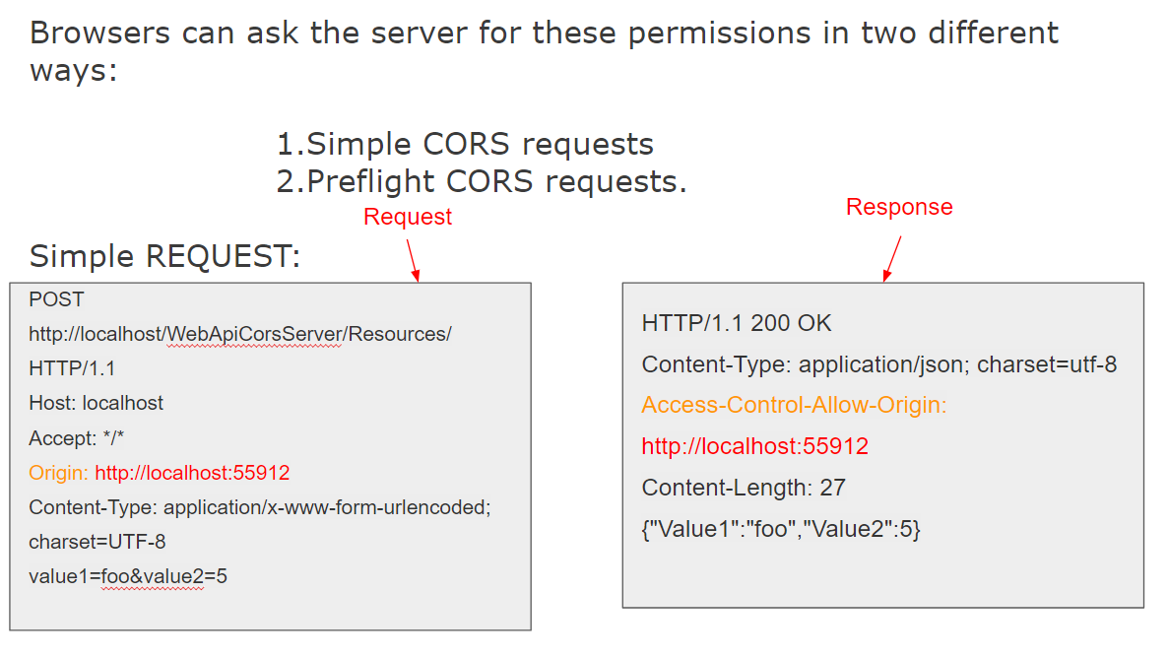

Slide 50
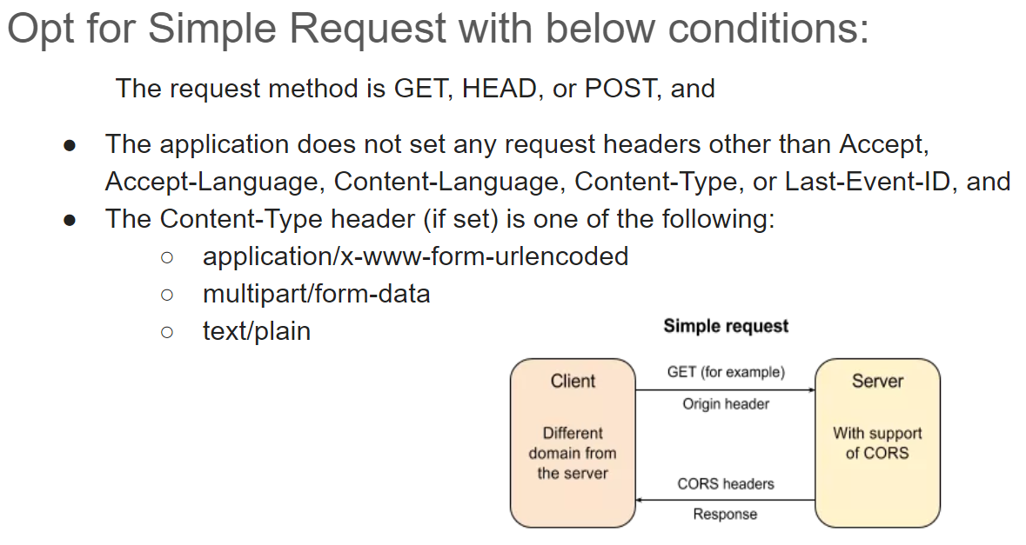

Slide 51
Preflight CORS Requests
For some CORS requests, the browser sends an additional request, called a "preflight request", before it sends the actual request for the resource.

Slide 52
Pre-Flight Requests
The preflight request uses the HTTP OPTIONS method. It includes two special headers:
Access-Control-Request-Method:
The HTTP method that will be used for the actual request.
Access-Control-Request-Headers:
A list of request headers that the application set on the actual request. (Again, this does not include headers that the browser sets.)

Slide 53
OPTIONS http://myservice.azurewebsites.net/api/test HTTP/1.1
Accept: */*
Origin: http://myclient.azurewebsites.net
Access-Control-Request-Method: PUT
Access-Control-Request-Headers: accept, x-my-custom-header
Accept-Encoding: gzip, deflate
User-Agent: Mozilla/5.0 (compatible; MSIE 10.0; Windows NT 6.2; WOW64; Trident/6.0)
Host: myservice.azurewebsites.net
Content-Length: 0
HTTP/1.1 200 OK
Cache-Control: no-cache
Pragma: no-cache
Content-Length: 0
Access-Control-Allow-Origin:
http://myclient.azurewebsites.net
Access-Control-Allow-Headers: x-my-custom-header
Access-Control-Allow-Methods: PUT
Date: Wed, 20 May 2015 06:33:22 GMT

Slide 54
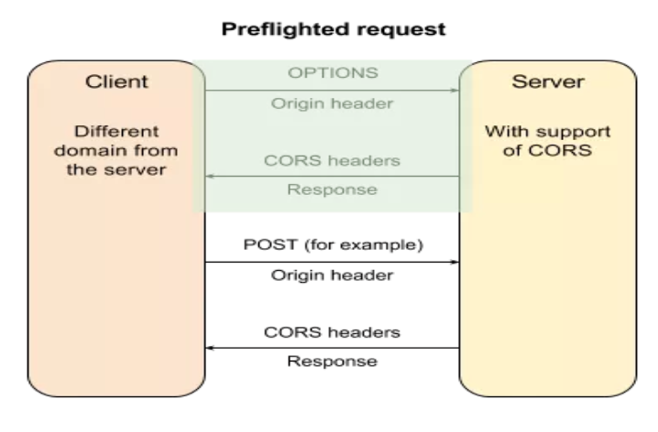
[
EnableCors("http://localhost:55912", // Origin "Accept, Origin, Content-Type", // Request headers "POST", // HTTP methods PreflightMaxAge=600 // Preflight cache duration )]

Slide 55
JSON and XML Serialization

Slide 56
Media Formatter: Abstract class from which all formatters inherit from.
1.JSON Media-Type Formatter
2.XML Media-Type Formatter
Accept header: application/json //result is in json format and
Accept header: application/xml //then result will be in xml format

Slide 57
Discuss About
How to return only XMLFormatter data / JSON Formatter data.
How to return JSON Instead of XML when request is made from browser?

Slide 58
JSON Media-Type Formatter
This Format provided from “JsonMediaTypeFormatter class” and this class uses Json.NET library to perform Serialization. If we want to use “DataContractJsonSerializer”/any other serializer then set
var json = GlobalConfiguration.Configuration.Formatters.JsonFormatter; json.UseDataContractJsonSerializer = true;

Slide 59
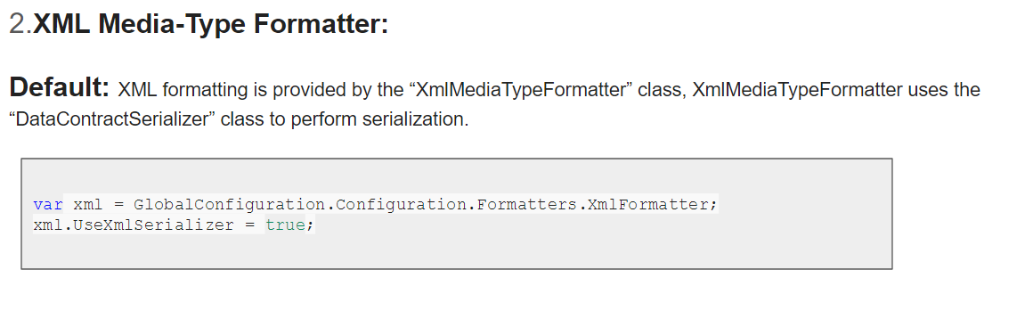
XML Media-Type Formatter

Slide 60
Circular Object References
If two properties refer to the same object, or if the same object appears twice in a collection, the formatter will serialize the object twice. This is a particular problem if your object graph contains cycles. serializer will throw an exception when it detects a loop in the graph.
var json = GlobalConfiguration.Configuration.Formatters.JsonFormatter; json.SerializerSettings.PreserveReferencesHandling = Newtonsoft.Json.PreserveReferencesHandling.All;
Now the controller action will return JSON that looks like this:
Response: {"$id":"1","Name":"Sales","Manager":{"$id":"2","Name":"Alice","Department":{"$ref":"1"}}}

Slide 61
Model Validations:
Client sends data to your web API, often you want to validate the data before doing any processing.
Data Annotations: Using Attributes from System.ComponentModel.DataAnnotations, to set validation rules for properties
[Required] public string Name { get; set; }
[Range(0, 999)] public double Weight { get; set; }

Slide 62
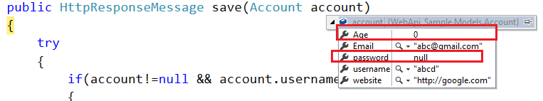
Model validation does not guarantee that client data is safe. Additional validation might be needed in other layers of the application
Under-Posting:

Slide 63
namespace MyApi.Filters {
public class ValidateModelAttribute : ActionFilterAttribute { public override void OnActionExecuting(HttpActionContext actionContext) { if (actionContext.ModelState.IsValid == false) { actionContext.Response = actionContext.Request.CreateErrorResponse( HttpStatusCode.BadRequest, actionContext.ModelState); } } } }

Slide 64
Global Level
Apply this filter to all Web API controllers:
Public static class WebApiconfig
{
Public static void Register(HttpConfiguration config)
{
config.Filters.Add(new validateModelAttribute());
}
}
[ValidateModelAttribute] public class ProductsController : ApiController { public HttpResponseMessage Post(Product product) { // ... } }
Controller Level

Slide 65
Authentication
and
Authorization

Slide 66
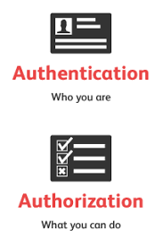

Slide 67
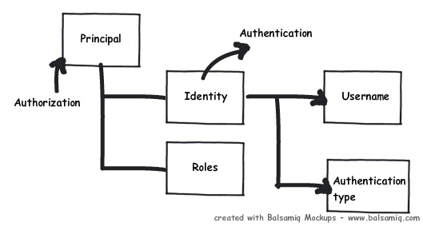
Detecting Authentication & Authorization
Notes:
At any moment of time if you want to know who the user is and what kind of authentication type he using you can use the identity object. If you want to know what kind of roles it’s associated with then we need to use the principal object. In other words to get authentication details we need to the identity object and to know about authorization details of that identity we need the principal object.
OWIN :
The Owin Middleware modules are responsible for handling the authentication with external authentication providers (such as Google) and establishing an application session through a cookie.

Slide 68
Access Token
An access token is an object that describes the security context of a process or thread.
The information in a token includes the identity and privileges of the user account associated with the process or thread
Refresh Token
A refresh token is a string that is used to get a new access token when an access token expires

Slide 69


Slide 70
OAuth
OAuth is an Open Authorization protocol which allows an end user's account information to be used by third-party services, such as Facebook, without exposing the user's password

Slide 71
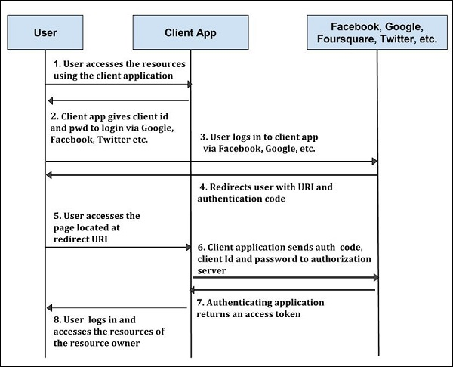
OAuth
Architecture

Slide 72
Authorization Filter

Slide 73
Goal :
To determine whether a user should be allowed access to a requested resource.
Types of Authorization Filter
Based on Roles
Users

Slide 74
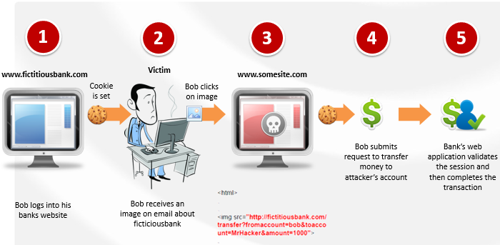
XSRF ATTACK

Slide 75
How To prevent XSRF?
A unique code shall be generated and stored in the form as a hidden field. The same token is also written stored in the cookies. On the server side we could cross check the token from the form with that of the token present in the cookie. If they do not match we can send an unauthorised response.
[ValidateAntiForgery] token is an attribute which does the same.

Slide 76
http://petstore.swagger.io/#/
SWAGGER

Slide 77


